Slide 1
CV Assignment 2
Reading Summary

Slide 2
OpenCV Tutorial: A Guide to Learn OpenCV
Image data formats
Images are arrays with dimensions (height, width, depth)
depth = number of color channels, e.g. 3 for RGB format
Each pixel’s RGB values are stored in a tuple (B, G, R) with ranges [0, 255] for each B, G, and R channel
Accessing a pixel’s BGR values given (x, y) coordinates in the image
image[y, x] yields (B, G, R) tuple for pixel (x, y)

Slide 3
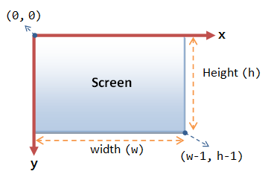
OpenCV Tutorial: A Guide to Learn OpenCV
Important note: Image coordinate system usually has origin at top left and positive y pointing down in the traditionally negative direction.

Slide 4
OpenCV Tutorial: A Guide to Learn OpenCV
Slice arrays to extract regions of images
image[startY:endY, startX:endX]
Resize images
cv2.resize(image, (width, height))
Rotate, Gaussian Blur, Draw line, Display text…
Important note: For rotations, the counterclockwise direction is positive and the clockwise direction is negative.

Slide 5

16 OpenCV Functions to Start your Computer Vision journey (with Python code)
Change color spaces
gray_image = cv2.cvtColor(image,cv2.COLOR_BGR2GRAY)
hsv_image = cv2.cvtColor(image,cv2.COLOR_BGR2HSV)
Translate images
Matrix representing a translation transformation:
M = np.float32([[1,0,tx],[0,1,ty]])
dst = cv2.warpAffine(image,M,(cols,rows))

Slide 6
16 OpenCV Functions to Start your Computer Vision journey (with Python code)
Simple image threshold for grayscale images
cv2.threshold(gray_image,127,255,cv2.THRESH_BINARY)
Arg 1: source grayscale image
Arg 2: threshold value used to classify the pixel values
Arg 3: maximum value assigned to pixel values exceeding the threshold
Arg 4: choose a threshold type from various options in OpenCV

Slide 7
16 OpenCV Functions to Start your Computer Vision journey (with Python code)
Edges are visual features that are useful for object detection and image segmentation i.e. partitioning or extracting certain regions of interest in images
Indicators of an edge include:
Depth discontinuity
Surface orientation discontinuity
Material property discontinuity (e.g. reflectance)
Illumination discontinuity (e.g. shadows, highlights)

Slide 8
Basic Features &
Feature Detection
Building blocks of semantic segmentation, object detection, point matching between images, object tracking, etc.

Slide 9
Edge Features
From earlier:
Edges are visual features that are useful for object detection and image segmentation i.e. partitioning or extracting certain regions of interest in images
Indicators of an edge include:
Depth discontinuity
Surface orientation discontinuity
Material property discontinuity (e.g. reflectance)
Illumination discontinuity (e.g. shadows, highlights)

Slide 10
Edge Features
Criteria for optimal edge detection (paraphrased from Silvio, Stanford, 2013)
High accuracy
few false positives caused by noisy images- robust to noise
few false negatives i.e. most real edges are detected
Good localization
detected edges should be close to the real (ground truth) edges
Single response constraint
detector should predict a single edge for each true edge

Slide 11
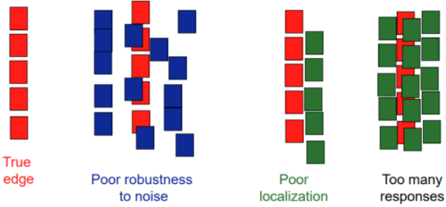
Edge Features
Criteria for optimal edge detection (paraphrased from Silvio, Stanford, 2013)

Slide 12
Corner Features
Criteria for optimal corner detection (paraphrased from Silvio, Stanford, 2013)
Repeatability
same feature can be detected in different images despite geometric and photometric transformations
Saliency
features are detected at ‘interesting’ regions in the image
Locality
feature occupies a ‘relatively’ small area of the image

Slide 13
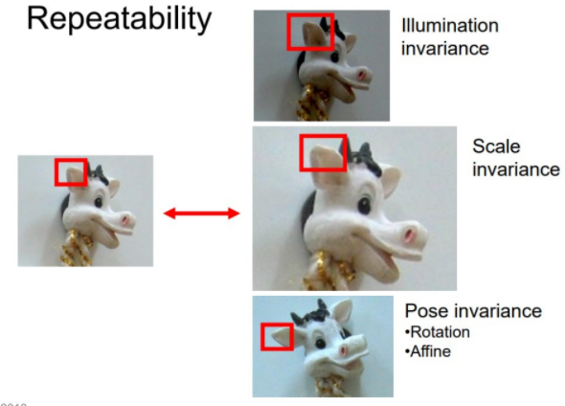
Corner Features
Criteria for optimal corner detection (paraphrased from Silvio, Stanford, 2013)

Slide 14
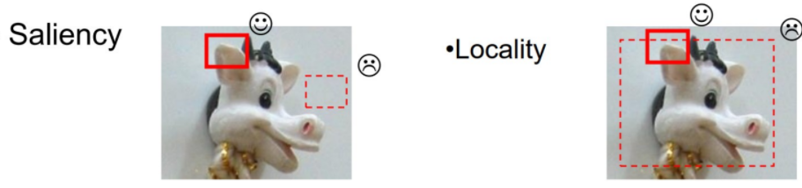
Corner Features
Criteria for optimal corner detection (paraphrased from Silvio, Stanford, 2013)

Slide 15
Other common features + terms
Features
Blobs, raw pixel values, bank of filters, etc
Many visual features for machine learning approaches are more abstract
Useful/common terms
Invariance (invariant to __. invariant with respect to ___, ___ invariant)
When we say a detection algorithm is invariant to __, it means that the detection algorithm is robust enough to handle changes in ___ and can detect the same corresponding features in different images of the feature
___ = scale, illuminance, pose, etc.

Slide 16
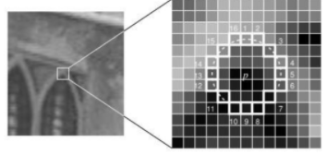
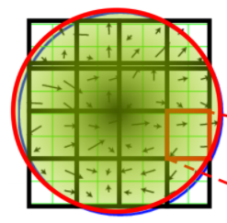
Other common features + terms
Common feature detection/descriptor algorithms (some patented)
FAST
SIFT
SURF
BRIEF
ORB
Other
Hough Transform
conversion between lines and a coordinate space
(Hough Space)

